Slide 1
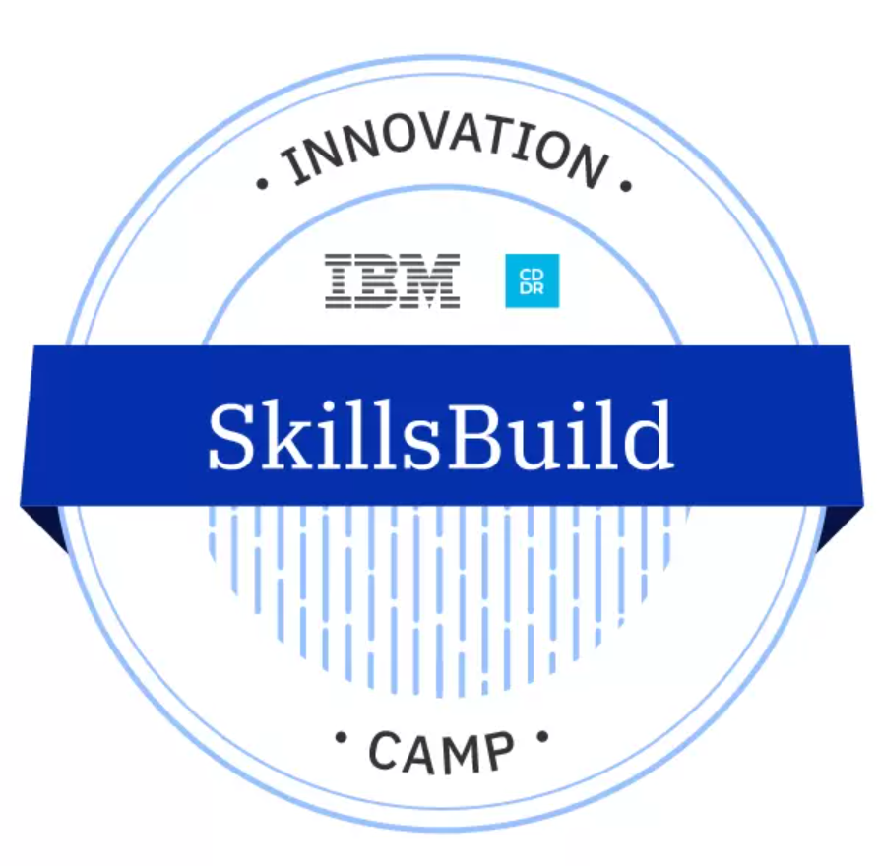

Final Project Presentation
By : Sachin Kumar Singh
AICTE Student ID : STU6079bc91184c41618590865

Slide 2

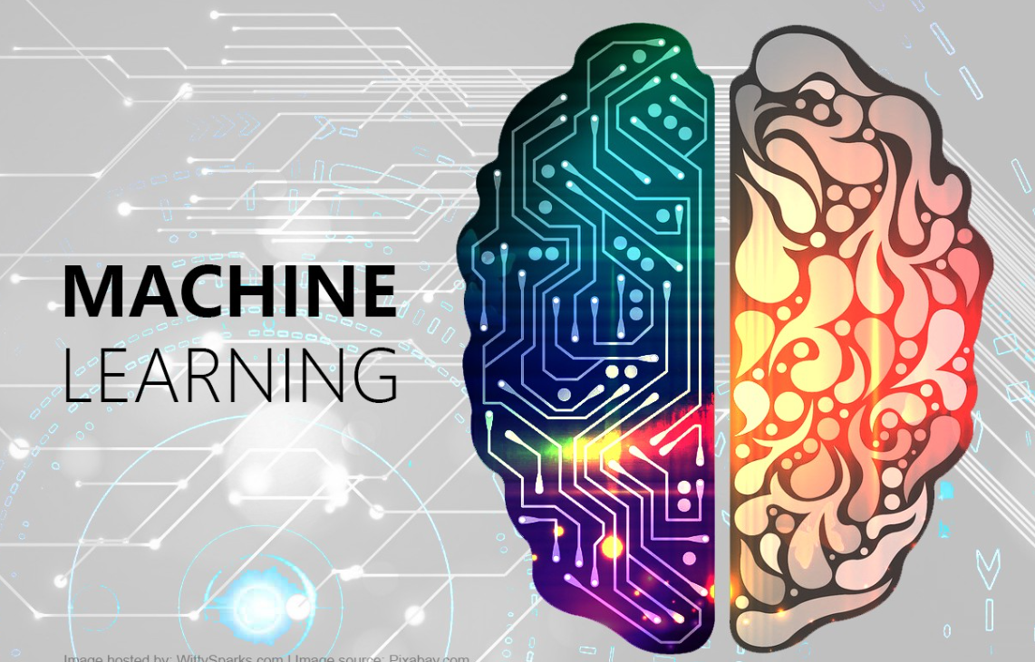
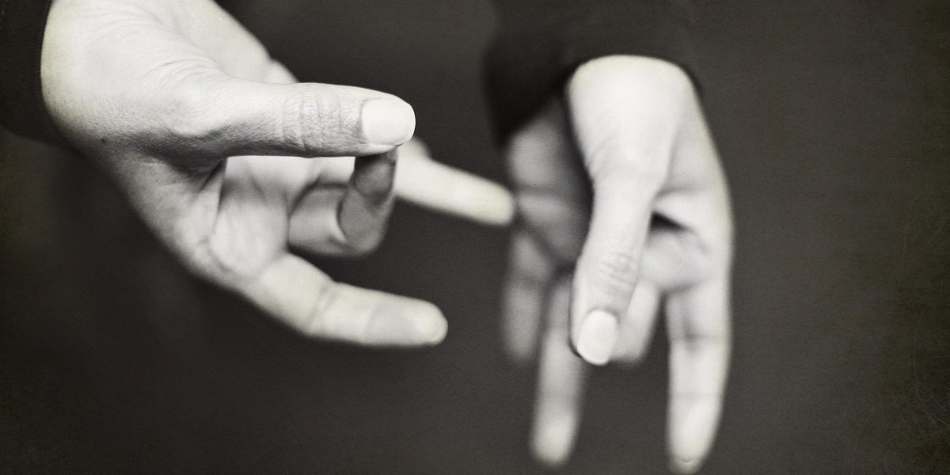
Project Title
AI Sign Language Recognition System with Python
+
=>

Slide 3
Agenda:
To develop a machine learning model that can recognise the Sign language and convert it into text so as to maintain proper communication between normal people and people with speaking problem.

Slide 4
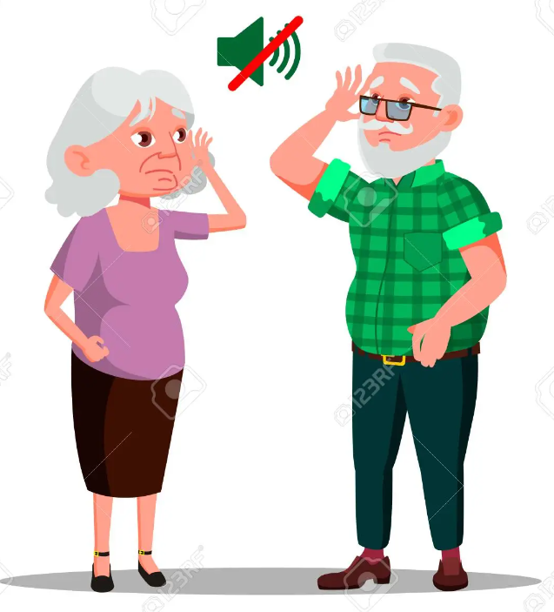
Problem Statement
Most people do not know sign language and interpreters are very difficult to come by.
Develop a Machine Learning model that that can recognize American Sign Language and convert it to text for better communication between people.

Slide 5
Project Overview

Slide 6
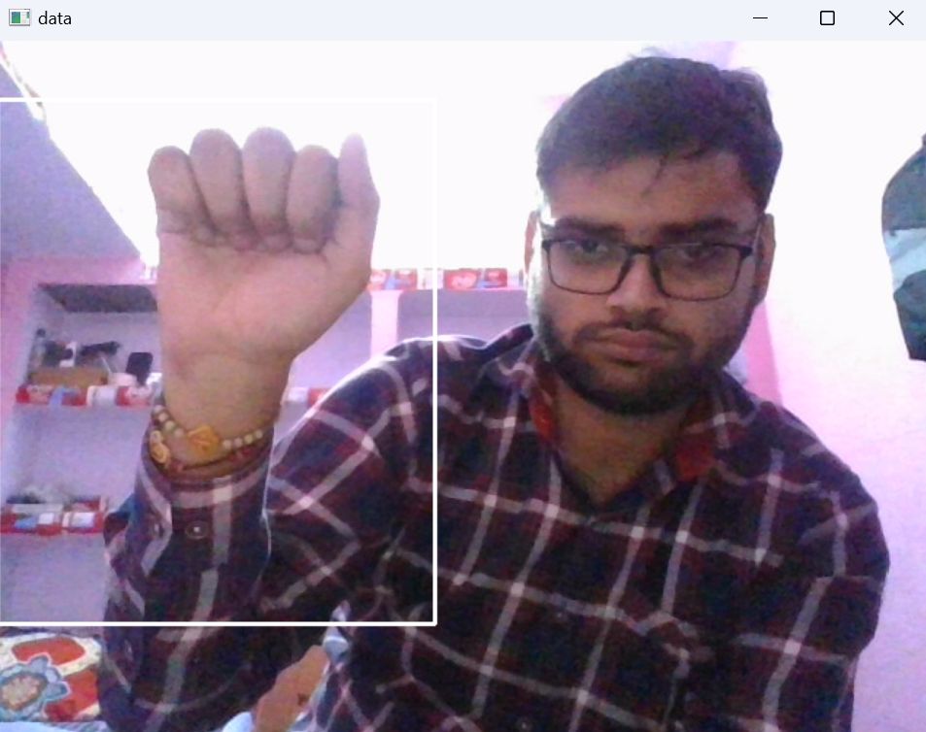
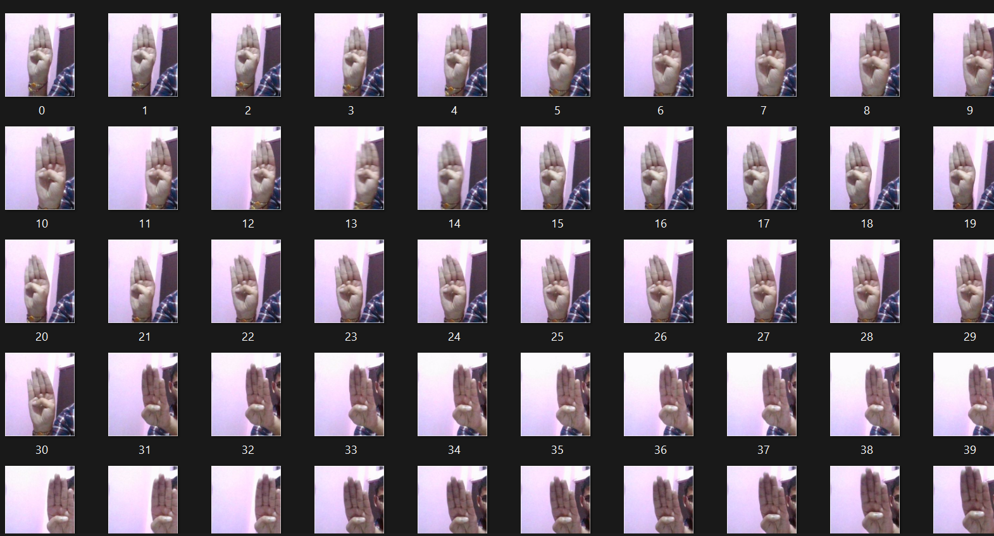
Data Collection
There was no proper data set that gives much accuracy so we developed our own dataset.

Slide 7
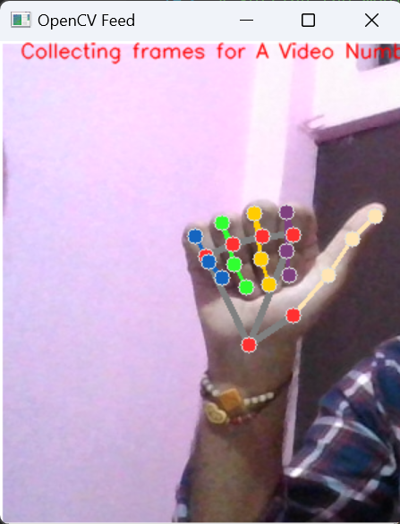
Collecting Landmarks of hands
We passed all our images through Mediapipe model to detect all the landmarks of our hands and store that data in .np files

Slide 8
Making Model
We have used 65 images for each alphabet with around 63 landmarks of hands.
We have used 3 Long Short Term Memory (LSTM) layers to make the model long term reliable to recognize a gesture.
Then, we have used 2 Dense layers so as to classify images based on output of above three LSTM layers.

Slide 9
Training the Model
We have trained our model by keeping epochs 500 so as to ensure better learning.
Also we have divided the dataset into 70:20 ratio.
70 percent data is for training and 30 percent data is for testing.
Our model accuracy was around 6.5.
After training the model we saved as model.h5.

Slide 10
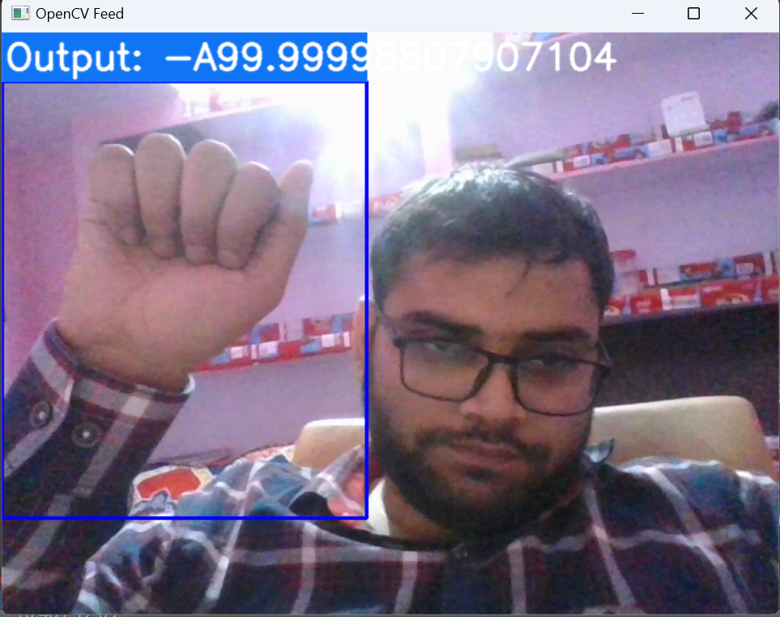
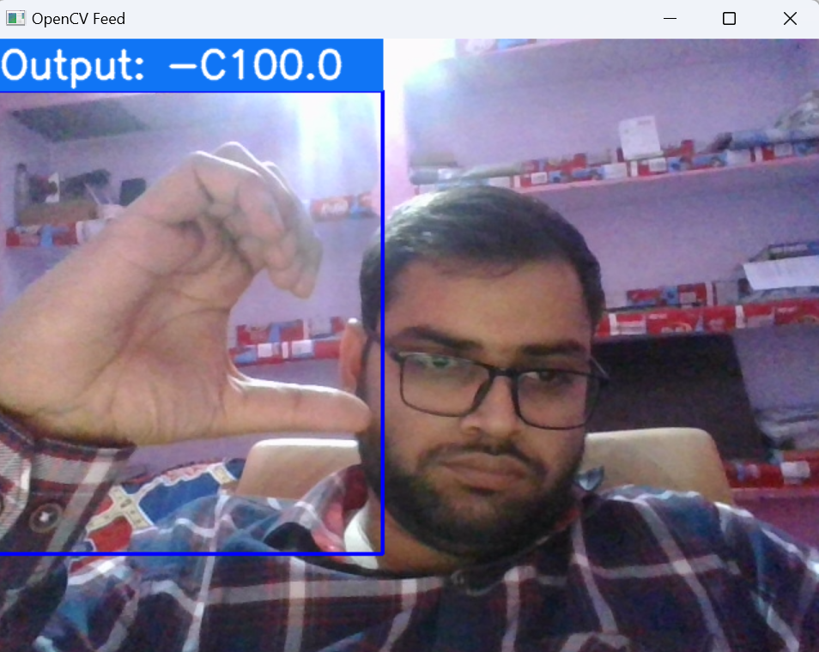
Testing the model
Recognizing ‘A’
Recognizing ‘C’

Slide 11
End Users
There are lots of people who are not able to speak. This model will be beneficial to them as through this model they can communicate their messages very easily.
It can also be embedded in various video calling apps and real time recognition will allow people to do smooth video calls by even with sign language

Slide 12
Our Solution
This model allows a person who don’t know American Sign Language to easily understand the gestures in American Sign Language and communicate better with people who can’t speak.
This will reduce the need to have a interpreter in between to communicate with people who can’t speak.
On another note, it will also save the cost of keeping a interpreter.
You just have to integrate this model with any chatting app or we can develop an individual app where a person can know the gestures meaning through that app.

Slide 13
Uniqueness
This model in future would not be limited to only American Sign Language (ASL) but also include Indian Sign Language (ISL).
This allows more and more people to connect with each other.
Also, if any user wants to feed his personalized gestures then it would also be supported.

Slide 14
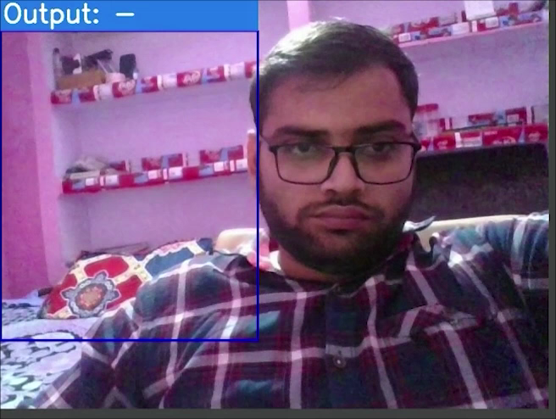
Results

Slide 15

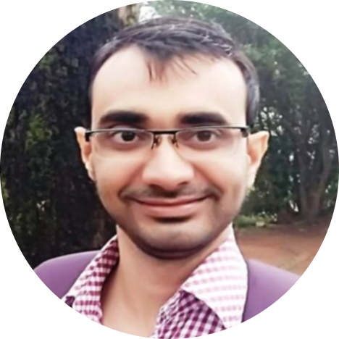
About
Mentee
Mentor
Sachin Kumar Singh
Bassar Patel

Slide 16
Thank You

